Slide 1
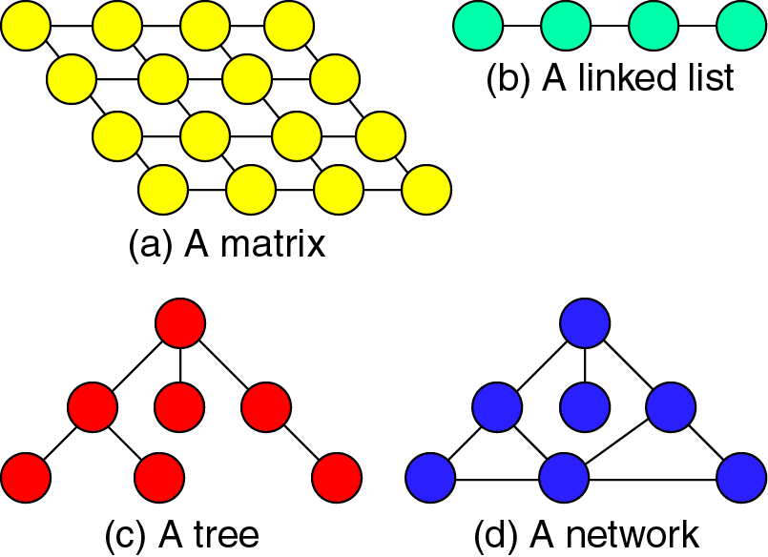
Figure 1-1

Slide 2
The ADT MODEL-

Slide 3
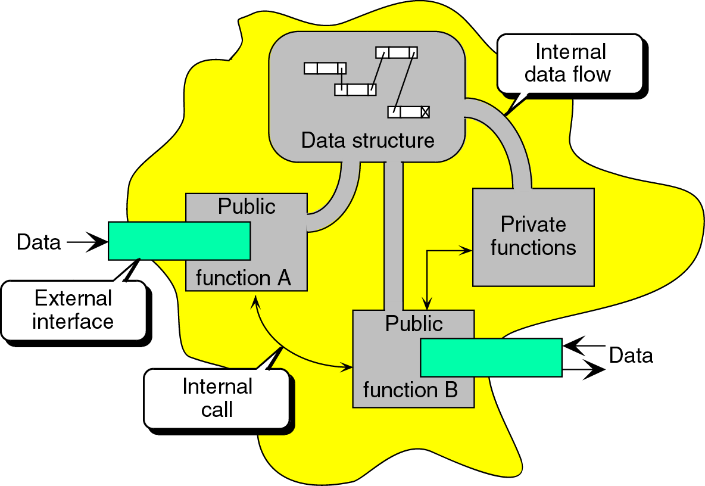
Figure 1-2

Slide 4
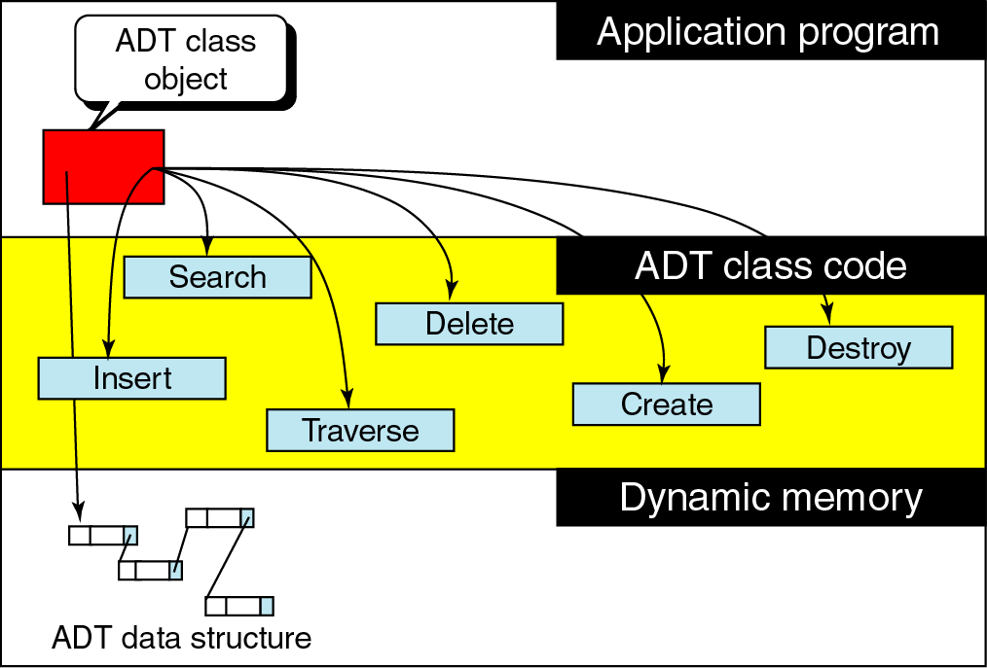
Figure 1-3

Slide 5
2-2 Designing Recursive Algorithms
In this section we present an analytical approach to designing recursive algorithms.
We also discuss algorithm designs that are not well suited to recursion.
The Design Methodology
Limitation of Recusion
Design Implemenation

Slide 6
The Design Methodology
Every recursive call either solves a part of the problem or it reduce the size of the problem.

Slide 7
The Design Methodology
Base case
  The statement that “solves” the problem.
  Every recursive algorithm must have a base case.
General case
  The rest of the algorithm
  Contains the logic needed to reduce the size of the problem.

Slide 8
Rules for designing a recursive algorithm
Determine the base case.
Determine the general case.
Combine the base case and the general cases into an algorithm.

Slide 9
Combine the base case and the general cases into an algorithm
Each call must reduce the size of the problem and move it toward the base case.
The base case, when reached, must terminate without a call to the recursive algorithms; that is, it must execute a return.

Slide 10
Limitations of recursion
You should not use recursion if the answer to any of the following questions is no:
  Is the algorithm or data structure naturally suited to recursion?
  Is the recursive solution shorter and more understandable?
  Does the recursive solution run within acceptable time and space limits?

